Slide 1
BIO Business Solutions Program

Slide 2
Office Depot / BIO Business Solutions Overview
Reduce operating costs with pre-negotiated discounts on thousands of products
Additional flexibility to meet your needs
Tiered volume rebates up to 3% directly to your organization
Additional product category discounts
Cleaning, Breakroom, Copy & Print, Furniture, Technology and IT Services
Cost savings tools to assist you in cost reduction efforts
Workflow approvals
Lower cost item suggestions
Reporting at your fingertips
Remote workers? Office Depot has you covered.
Employees have easy access to order through the BIO Business Solutions program for their home office needs.
https://community.officedepot.com/GPOHome?id=17767027
Delivery or In-store pick up
Virtual account management team and retail stores are open for business
Dedicated email – bio@officedepot.com
Dedicated National Program Manager sarah.glazier@officedepot.com ; 704-497-4022

Slide 3
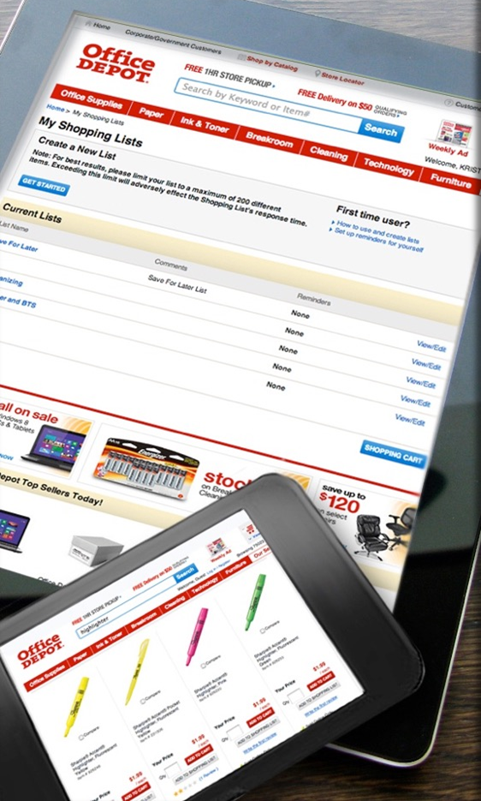
Your personalized shopping tool
Our cutting-edge website includes a variety of time-saving, customized features that are unique to our company. It’s so much more than just a place to shop. It’s a valuable tool that provides you with all the data and transparency that you need to make the smartest buying decisions possible.
Customized online tools
Best value program items
Customized shopping lists (based on the most frequently purchased products)
Bulletin Board communications
Real time product availability
Online spend management solutions
Auto-substitution
Product restrictions
Subscription services
Order approval levels
Online reporting tools
Order tracking
Proof of delivery
Returns
User-level reporting

Slide 4
Let’s work together to help your business be the best it can be!

